Slide 1
Object-Oriented Software Engineering
Practical Software Development using UML and Java
Chapter 11:
Managing the Software Process

Slide 2
11.1 What is Project Management?
Project management encompasses all the activities needed to plan and execute a project:
  Deciding what needs to be done
  Estimating costs
  Ensuring there are suitable people to undertake the project
  Defining responsibilities
  Scheduling
  Making arrangements for the work
  continued ...

Slide 3
What is Project Management?
  Directing
  Being a technical leader
  Reviewing and approving decisions made by others
  Building morale and supporting staff
  Monitoring and controlling
  Co-ordinating the work with managers of other projects
  Reporting
  Continually striving to improve the process

Slide 4
11.2 Software Process Models
Software process models are general approaches for organizing a project into activities.
  Help the project manager and his or her team to decide:
    What work should be done;
    In what sequence to perform the work.
  The models should be seen as aids to thinking, not rigid prescriptions of the way to do things.
  Each project ends up with its own unique plan.

Slide 5
The opportunistic approach

Slide 6
The opportunistic approach
… is what occurs when an organization does not follow good engineering practices.
  It does not acknowledge the importance of working out the requirements and the design before implementing a system.
  The design of software deteriorates faster if it is not well designed.
  Since there are no plans, there is nothing to aim towards.
  There is no explicit recognition of the need for systematic testing and other forms of quality assurance.
  The above problems make the cost of developing and maintaining software very high.

Slide 7
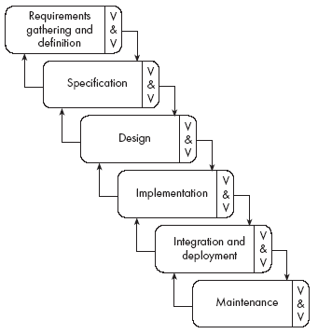
The waterfall model

Slide 8
The waterfall model
The classic way of looking at S.E. that accounts for the importance of requirements, design and quality assurance.
  The model suggests that software engineers should work in a series of stages.
  Before completing each stage, they should perform quality assurance (verification and validation).
  The waterfall model also recognizes, to a limited extent, that you sometimes have to step back to earlier stages.

Slide 9
Limitations of the waterfall model
  The model implies that you should attempt to complete a given stage before moving on to the next stage
    Does not account for the fact that requirements constantly change.
    It also means that customers can not use anything until the entire system is complete.
  The model makes no allowances for prototyping.
  It implies that you can get the requirements right by simply writing them down and reviewing them.
  The model implies that once the product is finished, everything else is maintenance.

Slide 10
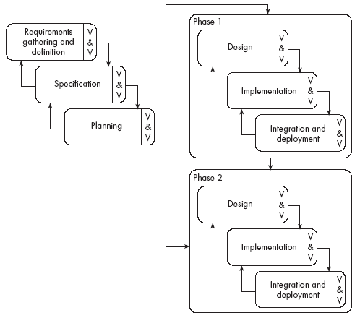
The phased-release model

Slide 11
The phased-release model
It introduces the notion of incremental development.
  After requirements gathering and planning, the project should be broken into separate subprojects, or phases.
  Each phase can be released to customers when ready.
  Parts of the system will be available earlier than when using a strict waterfall approach.
  However, it continues to suggest that all requirements be finalized at the start of development.

Slide 12
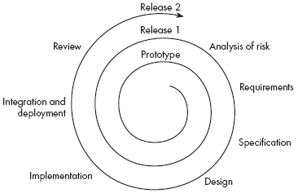
The spiral model

Slide 13
The spiral model
It explicitly embraces prototyping and an iterative approach to software development.
  Start by developing a small prototype.
  Followed by a mini-waterfall process, primarily to gather requirements.
  Then, the first prototype is reviewed.
  In subsequent loops, the project team performs further requirements, design, implementation and review.
  The first thing to do before embarking on each new loop is risk analysis.
  Maintenance is simply a type of on-going development.

Slide 14

The evolutionary model

Slide 15
The evolutionary model
It shows software development as a series of hills, each representing a separate loop of the spiral.
  Shows that loops, or releases, tend to overlap each other.
  Makes it clear that development work tends to reach a peak, at around the time of the deadline for completion.
  Shows that each prototype or release can take
    different amounts of time to deliver;
    differing amounts of effort.

Slide 16
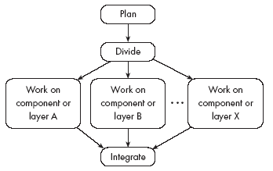
The concurrent engineering model

Slide 17
The concurrent engineering model
It explicitly accounts for the divide and conquer principle.
  Each team works on its own component, typically following a spiral or evolutionary approach.
  There has to be some initial planning, and periodic integration.

Slide 18
The Rational Unified process
This is the most widely known methodology that embraces UML
  Designed to be adaptable
  Suggests a process framework
  Adapts to the project needs
  Use-case-driven development
  Architecture-centric process

Slide 19
Agile approaches
These approaches encourage the development of particularly small iterations
  Well suited for small projects that involve uncertain, changing requirements and other high risk
  The most famous agile technique is eXtreme Programming (XP)
    All stakeholders work closely together
    User stories are written instead of requirement document
    There must be a series of small and frequent releases (1 to 3 weeks)
    The project variable are: scope, resources and time (and quality)
    Test cases are written before the software is developed
    A large amount of refactoring is encouraged
    Pair programming is recommended

Slide 20
Choosing a process model
  From the waterfall model:
    Incorporate the notion of stages.
  From the phased-release model:
    Incorporate the notion of doing some initial high-level analysis, and then dividing the project into releases.
  From the spiral model:
    Incorporate prototyping and risk analysis.
  From the evolutionary model:
    Incorporate the notion of varying amounts of time and work, with overlapping releases.
  From concurrent engineering:
    Incorporate the notion of breaking the system down into components and developing them in parallel.

Slide 21
Reengineering
Periodically project managers should set aside some time to re-engineer part or all of the system
  The extent of this work can vary considerably:
    Cleaning up the code to make it more readable.
    Completely replacing a layer.
    Re-factoring part of the design.
  In general, the objective of a re-engineering activity is to increase maintainability.

Slide 22
11.3 Cost estimation
To estimate how much software-engineering time will be required to do some work.
  Elapsed time
    The difference in time from the start date to the end date of a task or project.
  Development effort
    The amount of labour used in person-months or person-days.
    To convert an estimate of development effort to an amount of money:
      You multiply it by the weighted average cost (burdened cost) of employing a software engineer for a month (or a day).

Slide 23
Principles of effective cost estimation
Principle 1: Divide and conquer.
  To make a better estimate, you should divide the project up into individual subsystems.
  Then divide each subsystem further into the activities that will be required to develop it.
  Next, you make a series of detailed estimates for each individual activity.
  And sum the results to arrive at the grand total estimate for the project.

Slide 24
Principles of effective cost estimation
Principle 2: Include all activities when making estimates.
  The time required for all development activities must be taken into account.
  Including:
      Prototyping
      Design
      Inspecting
      Testing
      Debugging
      Writing user documentation
      Deployment.

Slide 25
Principles of effective cost estimation
Principle 3: Base your estimates on past experience combined with knowledge of the current project.
  If you are developing a project that has many similarities with a past project:
    You can expect it to take a similar amount of work.
  Base your estimates on the personal judgement of your experts
    or
  Use algorithmic models developed in the software industry as a whole by analyzing a wide range of projects.
    They take into account various aspects of a project’s size and complexity, and provide formulas to compute anticipated cost.

Slide 26
Algorithmic models
Allow you to systematically estimate development effort.
  Based on an estimate of some other factor that you can measure, or that is easier to estimate:
    The number of use cases
    The number of distinct requirements
    The number of classes in the domain model
    The number of widgets in the prototype user interface
    An estimate of the number of lines of code

Slide 27
Algorithmic models
  A typical algorithmic model uses a formula like the following:
    COCOMO:
    Functions Points:
E = a + bN^{c}
S = W₁F₁ + W₂F₂ +W₃F₃ + …

Slide 28
Principles of effective cost estimation
Principle 4: Be sure to account for differences when extrapolating from other projects.
  Different software developers
  Different development processes and maturity levels
  Different types of customers and users
  Different schedule demands
  Different technology
  Different technical complexity of the requirements
  Different domains
  Different levels of requirement stability

Slide 29
Principles of effective cost estimation
Principle 5: Anticipate the worst case and plan for contingencies.
  Develop the most critical use cases first
    If the project runs into difficulty, then the critical features are more likely to have been completed
  Make three estimates:
    Optimistic (O)
      Imagining a everything going perfectly
    Likely (L)
      Allowing for typical things going wrong
    Pessimistic (P)
      Accounting for everything that could go wring

Slide 30
Principles of effective cost estimation
Principle 6: Combine multiple independent estimates.
  Use several different techniques and compare the results.
  If there are discrepancies, analyze your calculations to discover what factors causing the differences.
  Use the Delphi technique.
    Several individuals initially make cost estimates in private.
    They then share their estimates to discover the discrepancies.
    Each individual repeatedly adjusts his or her estimates until a consensus is reached.

Slide 31
Principles of effective cost estimation
Principle 7: Revise and refine estimates as work progresses
  As you add detail.
  As the requirements change.
  As the risk management process uncovers problems.

Slide 32
11.4 Building Software Engineering Teams
Software engineering is a human process.
  Choosing appropriate people for a team, and assigning roles and responsibilities to the team members, is therefore an important project management skill
  Software engineering teams can be organized in many different ways

Slide 33
Software engineering teams
Egoless team:
  In such a team everybody is equal, and the team works together to achieve a common goal.
  Decisions are made by consensus.
  Most suited to difficult projects with many technical challenges.

Slide 34
Software engineering teams
Hierarchical manager-subordinate structure:
  Each individual reports to a manager and is responsible for performing the tasks delegated by that manager.
  Suitable for large projects with a strict schedule where everybody is well-trained and has a well-defined role.
  However, since everybody is only responsible for their own work, problems may go unnoticed.

Slide 35
Software engineering teams
Chief programmer team:
  Midway between egoless and hierarchical.
  The chief programmer leads and guides the project.
  He or she consults with, and relies on, individual specialists.

Slide 36
Choosing an effective size for a team
  For a given estimated development effort, in person months, there is an optimal team size.
    Doubling the size of a team will not halve the development time.
  Subsystems and teams should be sized such that the total amount of required knowledge and exchange of information is reduced.
  For a given project or project iteration, the number of people on a team will not be constant.
  You can not generally add people if you get behind schedule, in the hope of catching up.

Slide 37
Skills needed on a team
  Architect
  Project manager
  Configuration management and build specialist
  User interface specialist
  Technology specialist
  Hardware and third-party software specialist
  User documentation specialist
  Tester

Slide 38
11.5 Project Scheduling and Tracking
  Scheduling is the process of deciding:
    In what sequence a set of activities will be performed.
    When they should start and be completed.
  Tracking is the process of determining how well you are sticking to the cost estimate and schedule.

Slide 39
PERT charts
A PERT chart shows the sequence in which tasks must be completed.
  In each node of a PERT chart, you typically show the elapsed time and effort estimates.
  The critical path indicates the minimum time in which it is possible to complete the project.

Slide 40
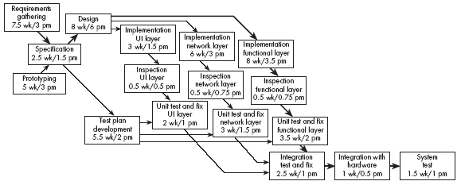
Example of a PERT chart

Slide 41
Gantt charts
A Gantt chart is used to graphically present the start and end dates of each software engineering task
  One axis shows time.
  The other axis shows the activities that will be performed.
  The black bars are the top-level tasks.
  The white bars are subtasks
  The diamonds are milestones:
    Important deadline dates, at which specific events may occur

Slide 42
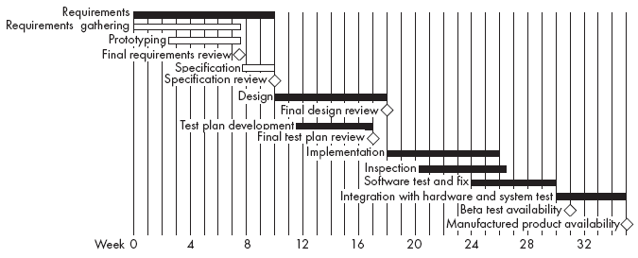
Example of a Gantt chart

Slide 43
Earned value
  Earned value is the amount of work completed, measured according to the budgeted effort that the work was supposed to consume.
  It is also called the budgeted cost of work performed.
  As each task is completed, the number of person-months originally planned for that task is added to the earned value of the project.

Slide 44
Earned value charts
An earned value chart has three curves:
  The budgeted cost of the work scheduled.
  The earned value.
  The actual cost of the work performed so far.

Slide 45
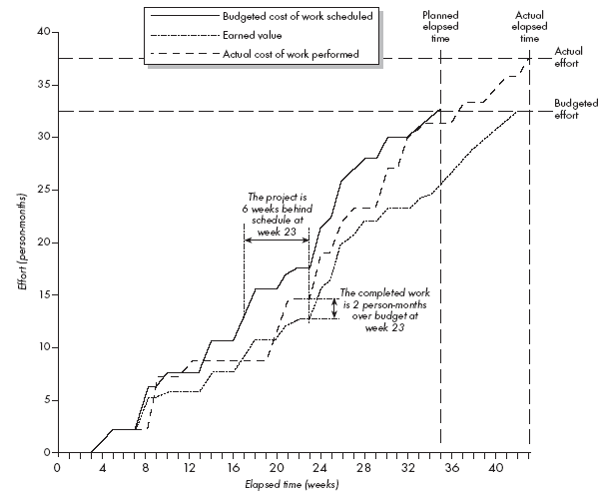
Example of an earned value chart

Slide 46
11.6 Contents of a Project Plan
Purpose
Background information
Processes to be used
Subsystems and planned releases
Risks and challenges
Tasks
Cost estimates
Team
Schedule and milestones

Slide 47
11.7 Difficulties and Risks in Project Management
  Accurately estimating costs is a constant challenge
    Follow the cost estimation guidelines.
  It is very difficult to measure progress and meet deadlines
    Improve your cost estimation skills so as to account for the kinds of problems that may occur.
    Develop a closer relationship with other members of the team.
    Be realistic in initial requirements gathering, and follow an iterative approach.
    Use earned value charts to monitor progress.

Slide 48
Difficulties and Risks in Project Management
  It is difficult to deal with lack of human resources or technology needed to successfully run a project
    When determining the requirements and the project plan, take into consideration the resources available.
    If you cannot find skilled people or suitable technology then you must limit the scope of your project.

Slide 49
Difficulties and Risks in Project Management
  Communicating effectively in a large project is hard
    Take courses in communication, both written and oral.
    Learn how to run effective meetings.
    Review what information everybody should have, and make sure they have it.
    Make sure that project information is readily available.
    Use ‘groupware’ technology to help people exchange the information they need to know

Slide 50
Difficulties and Risks in Project Management
  It is hard to obtain agreement and commitment from others
    Take courses in negotiating skills and leadership.
    Ensure that everybody understands
      The position of everybody else.
      The costs and benefits of each alternative.
      The rationale behind any compromises.
    Ensure that everybody’s proposed responsibility is clearly expressed.
    Listen to everybody’s opinion, but take assertive action, when needed, to ensure progress occurs.

